Slide 1
A practical guide to developing effective Web-based learning
指導教授: 陳 明 溥
研 究 生: 許 良 村
Cook, D.A., Dupras, D.M.(June,2004). A practical guide to developing effective Web-based learning. Journal of General Internal Medicine.19(6),698-707. ( Retrived March 14, 2005, from Web site: http://www.blackwell-synergy.com )

Slide 2
Objective
Online learning has changed medical education, but many “educational”websites do not employ principles of effective learning.
This article will assist readers in developing effective educational websites by integrating principles of active learning with the unique features of the Web.

Slide 3
Ten steps to effective web-based learning
Preparatory steps:
1.Perform a needs analysis and specify goals and objectives
2.Determine your technical resources and needs
3.Evaluate preexisting software and use it if it fully meets your needs
4.Secure commitment from all participants and identify and address potential barriers to implementation

Slide 4
Ten steps to effective web-based learning
Development steps:
5.Develop content in close coordination with website design
6.Encourage active learning -self-assessment, reflection,self-directed learning, problem-based learning,learner interaction, and feedback
7.Facilitate and plan to encourage use by the learner
8.Evaluate-both learners and course

Slide 5
Ten steps to effective web-based learning
Implementation and Maintenance:
9.Pilot the website before full implementation
10.Plan to monitor online communication and maintain the site by resolving technical problems, periodically verifying hyperlinks, and regularly updating content

Slide 6
Step 1. Perform a needs analysis and specify goals and objectives
Needs analysis including :
- problem identification
- assessment of learners’ needs
- assessment of the teaching environment
Consider the gap between learners’ current and ideal performance
- knowledge
- skill
- attitude
- behavior

Slide 7
Step 2. Determine your technical resources and needs
Content expert
Education expert
Programmer
Courseware
Computer skills
Equipment

Slide 8
Step 3. Evaluate commercial software and use it if it fully meets your needs
First decide whether it aligns with your goals and objectives.
Next determine whether the product will work on your network (consult your specialist).
Most importantly, evaluate how well it capitalizes on Web resources (Step 5), promotes active learning (Step 6), and provides for evaluation (Step 8).

Slide 9
Step 4. Secure commitment from all participants and identify and address potential barriers to implementation
Potential barriers include:
- inadequate computer skills?
- insufficient time?
- attitude?

Slide 10
Step 5. Develop content in close coordination with website design
This step and step6 must be done together, in close harmony
Posting previously-developed content on the Web with little or no modification is ineffective
Existing content can form a basis for the course, but should be modified to incorporate principles of Web design

Slide 11
Step 5. Develop content in close coordination with website design
by Appropriately Using Multimedia, Hyperlinks, and Online Communication.
Principles of effective Web page design:
- clear headings
- consistent and clearly defined navigation
- bulleted text, short sentences
- avoid use of underlining (except for links)

Slide 12
Step 5. Develop content (cont.)
- Multimedia
Multimedia refers to the simultaneous use :
- text (font, color, and size )
- sound
- images
- animation
- video (with or without sound)
- slideshow (with or without narration) ,…

Slide 13
Step 5. Develop content (cont.)
- Multimedia
multimedia use --four caveats :
- it is easy to “overdo” it
- it is no substitute for good instructional
design
- keep in mind the issue of download speed
- pay attention to copyright law

Slide 14
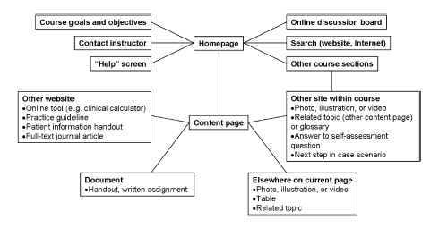
Step 5. Develop content (cont.)
- Hyperlink

Slide 15
Step 5. Develop content (cont.)
- Online Communication
-Method: synchronous,asynchronous
-Tool: email,chat rooms,online discussion board, msn,audio and video conferencing

Slide 16
Table 2. Characteristics of Effectively Designed Webpages by Krug,Horton
Clear and Consistent Page Organization
-Hierarchy of importance for items on the page, with more important things higher on page
-Logical groupings, with visual cues to help organize groups
-Headings and navigation labels reflecting a single theme (e.g., topic, function, or sequence)
-Consistent format from page to page

Slide 17
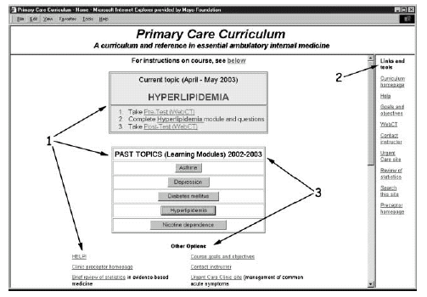
A well-designed educational website: the home page

Slide 18
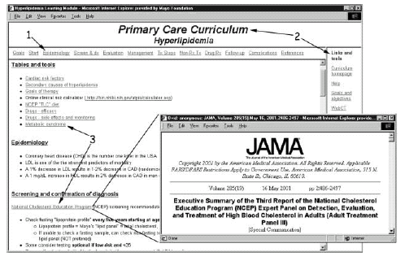
A well-designed educational website: a “content” page

Slide 19
Characteristics of Effectively Designed Webpages
Wise Use of Space
-Division of page into grid of defined areas
-Alignment of all screen elements horizontally and vertically
-Limited unused space (webpages require less white space than paper)
-Few distractions (e.g., unnecessary color, graphics, or animation)

Slide 20
Characteristics of Effectively Designed Webpages
Concise Text that Facilitates “scanning”
-Clear headings
-Short phrases and bulleted outlines
-Limited length of sentences (20 words) and paragraphs (5 sentences)
-Limited page length (single screen for homepage, scrolling limited to 3 screens for other pages)
-Topic summarized before presenting detail

Slide 21
Characteristics of Effectively Designed Webpages
Clear and Consistent Navigation
-Site name/logo on every page with consistent position and appearance
-Navigation bar on every page with consistent position,appearance, and content including:
--Link to homepage
--Links to sections/categorie
--Search function
--Utilities (help, additional information,
contact information, etc.)
--Navigation bar on right

Slide 22
Characteristics of Effectively Designed Webpages
Clear and Consistent Hyperlinks
-Clearly identified hyperlinks
-Descriptive and unambiguous hyperlink labels
-No use of graphics as hyperlinks
-Repetition of important hyperlinks elsewhere on the page
-Minimum number of “clicks” to access a given point (“flat” site architecture)
-Consistent hyperlink format on all pages

Slide 23
Step 6. Encourage active learning
This is the most important step.
The key to active learning is involvement of the learner in the learning process-encouraging them to apply new information.
active learning methods:
- self assessment
- reflection
- self-directed learning
- problem-based learning
- learner interaction
- feedback

Slide 24
Step 6. Encourage active learning
Self-assessment:
-Online pretests and posttests
-with correct answers and justification provided immediately
Reflection:
-include learner interaction and online personal journals and portfolios.
Application:
-cases and simulations

Slide 25
Step 6. Encourage active learning
Self-directed learning:
-It is a process in which individuals take the initiative, with or without the help of others," to diagnose their learning needs, formulate learning goals, identify resources for learning, select and implement learning strategies, and evaluate learning outcomes (Knowles 1975).

Slide 26
Step 6. Encourage active learning
Evidence-based learning:
1. Interview and examine the patient
2. This usually results in multiple questions about the dilemma the patient faces. Select one carefully framed question which is chosen for evaluation.
3. Use computer searching techniques to obtain the scientific evidence most likely to answer the selected question.

Slide 27
Step 6. Encourage active learning
4. Use explicit criteria to critically appraise the evidence for validity and applicability.
5. Combine this evidence with experience with other patients with similar problems to answer the question.
6. Finally, this knowledge (or lack of knowledge) must be related to our particular patient's circumstance and discussed with the patient to determine their preferences.

Slide 28
Step 6. Encourage active learning
Problem-based learning:
- an instructional method that challenges students to "learn to learn," working cooperatively in groups to seek solutions to real world problems.
- An approach to learning grounded in cognitively based learning theories in which teachers encourage students to learn by actively engaging them in instructional strategies that focus on problem-solving.

Slide 29
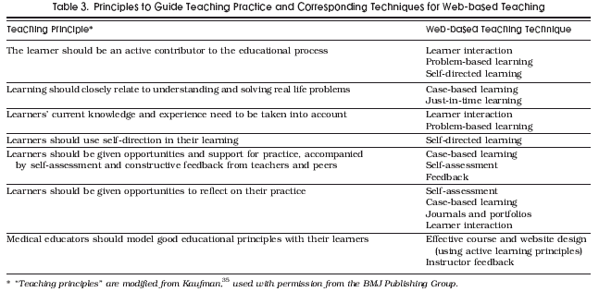
Notes:
The learner should be an active contributor to the educational process
在教育的過程中,學習者扮演一個主動貢獻者的角色(ex. 合作學習)
2. Learning should closely relate to understanding and solving real life problems
學習在於解決真實生活上的問題
3. Learners’ current knowledge and experience need to be taken into account
學習者目前擁有的知識與經驗需要被考慮時
4. Learners should use self-direction in their learning
學習者將做自我導向學習時
5. Learners should be given opportunities and support for practice, accompanied by self-assessment and constructive feedback from teachers and peers
學習者由老師及同儕獲得建設性回饋的機會及得到練習支持及進行自評(?????)
6. Medical educators should model good educational principles with their learners
醫學教師將塑造好的教育原理以符合學習者的需求

Slide 30
Step 7. Facilitate and plan to encourage use by the learner
Make the Website Accessible and User-friendly:
- place links to the course
- periodically email residents the link
- adhere to guideline for attractive and usable websites
- avoid passwords
Provide Time for Learning :

Slide 31
Motivate and Remind :
- pre-test(highlight learning needs)
- case-based problems(emphasize relevance of what they are learning)
- self assessment and feedback(provide a positive affective experience)
- post-test with answers and individualized feedback(reinforce learning)
- periodic email reminders

Slide 32
Step 8. Evaluate-both learners and course
Assess learners:
- self-assessment questions with feedback(formative assessment) during course
- post-test with feedback(formative and summative assessment;via WebCT)
- chart audit in six months to see if behavior changes

Slide 33
Step 8. Evaluate-both learners and course
Evaluate the course
- development:time required, resources used
- use:rate of completion and ongoing use
- objectives:
effect on achievement-learner test scores
effect on behavior-chart audit in six months
- student perceptions and suggestions-post-module survey

Slide 34
Step 9. Pilot the website before full implementation
First pilot-informal presentation of screen “mock up” to get feedback
Second pilot-”usability testing”

Slide 35
Step 10. Plan to monitor and maintain site
resolving technical problems
Test periodically all hyperlinks
regularly updating content

Slide 36
Conclusion
Teaching on the Web involves more than putting together a colorful webpage.
By consistently employing principles of effective learning.

